Slide 1
Evaluate Prices for Big Mountain Resort
Could we change the prices? If we capitalize our facilities as much as we could, based on what?

Slide 2
Basing their pricing on just the market average does not provide the business with a
good sense of how important some facilities are compared to others. This hampers
investment strategy
The company would like guidance on how to select a better value for your ticket price, especially now that we recently installed an additional chairlift to help increase visitor distribution around the mountain. This additional chair increases our operating costs by $ 1,540,000 this season.
The resort's pricing strategy has been to charge a premium above the average price of the resorts in its market segment. We know that this approach has limitations. There is a suspicion that Big Mountain is not capitalizing on its facilities as much as it could.

Slide 3
Recommendation and key findings
Big Mountain currently charges $81 dollars per ticket. At first modelling suggested an increase until $95.87 supported in the marketplace by Big Mountains facilities.Even with the expected mean absolute error of $10.39, this suggests there is room for an increase.
We checked different scenarios.For example: if Big Mountain is adding a run, increasing the vertical drop by 150 feet and installing an additional chairlift could increase support for the additional price by $ 1.99 During the season, this could be expected to go up to $ 3,474,638 per year
If we increase the longest run by .2 miles and guaranteeing its snow coverage by adding 4 acres of snow making capability. No difference whatsoever.
We consider the prices of the weekend tickets and I suggest to also check the price of the night ski and if we have information related to the use of electricity and the maintenance of the chairlift systems it would be even better to evaluate and see the impact on the price

Slide 4
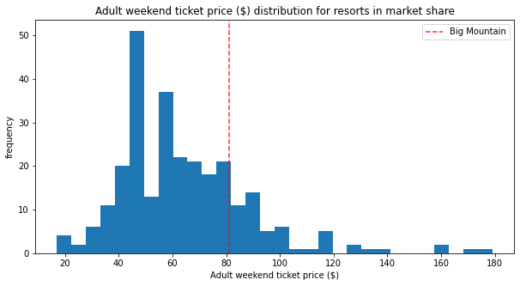
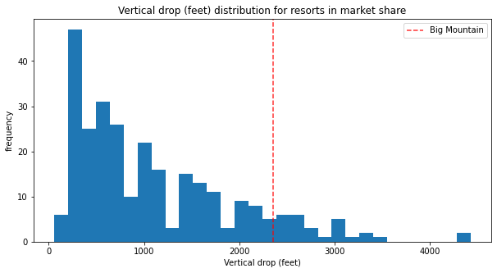
Modeling results and analysis
A
B
We see in the First graphic A:Adult Weekend price of our Resort is not the highest prices nor lowest, for that reason we should calculate based on mean absolute error of our Forest Random Model: The best model based on a lower cross-validation mean absolute error. It also exhibits less variability and verifying performance on the test set produces performance consistent with the cross-validation results. The Second graphic B show us how good is our Vertical Drop compare with the others Resorts

Slide 5
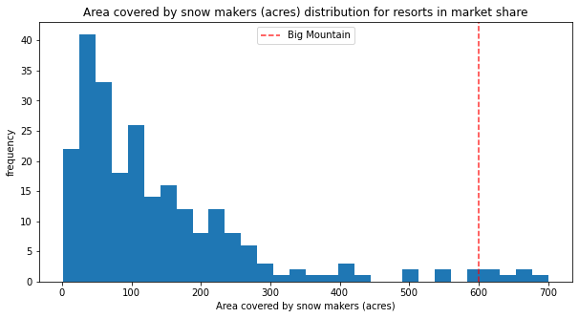
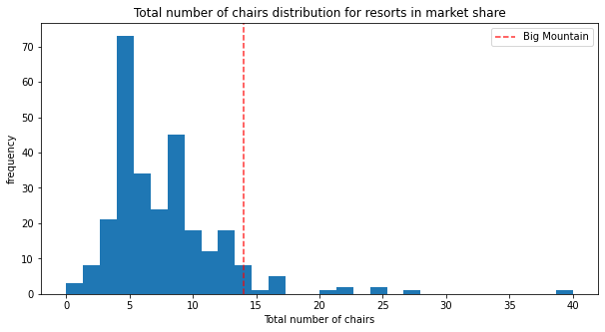
C D
Graph C shows the area covered by snow, among other Resorts, and D the total number of chairs, which is also quite high compared to other Resorts.Ticket price is not determined by any set of parameters; the resort is free to set whatever price it likes. However, the resort operates within a market where people pay more for certain facilities, and less for others. Being able to sense how facilities support a given ticket price is valuable business intelligence. This is where the utility of our model comes in.

Slide 6
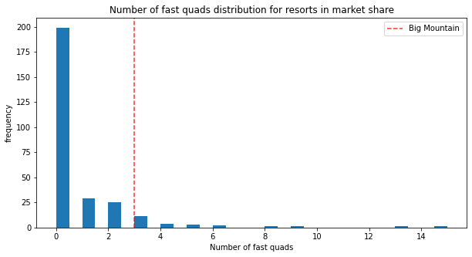
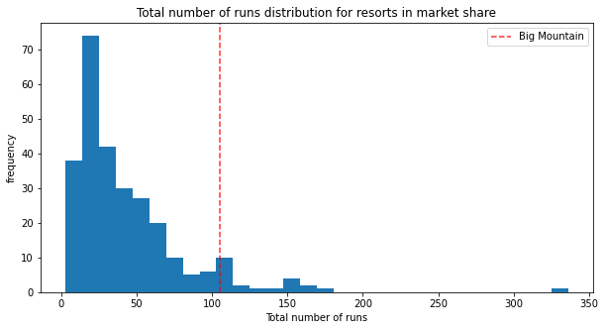
E
F
Graphics show us: Fast quads E and number of runs F is amongst the highest

Slide 7
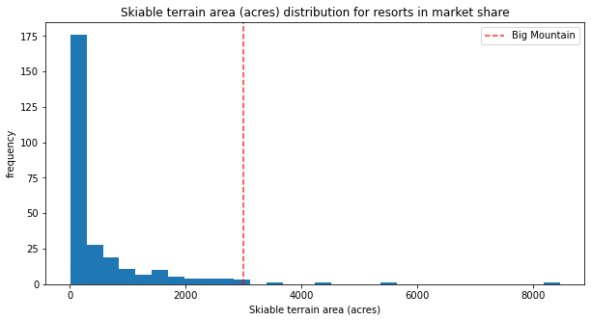
G
Skiable terrain is pretty high amongst US resorts.We select certain facilities that increase the price of the Resort according to the model, that is why we review different scenarios

Slide 8
Conclusions:
Based on our model and graphics obtained we can assume that increasing price of 15% over actual price represent a necessary and recomendable action to amortize the expenses that we have, with the new investment, to compensate the expenses associated with the Electricity, maintenance services and optimize the profits derived from the facilities that the Big Mountain Resort has.

